Slide 1
List of Projects introduced on Tuesday 10-12
for UT Introduction to Data Science course LTAT.02.002
2021 Fall

Slide 2
Instructions
Please make a copy of the template slide and paste it as a new last page of this document, then fill in the details, following our example of Project B0.
Project number:
Please take the next integer, so that project numbers are B1,B2,B3,...
Project name:
Please write the name of the project in UPPERCASE
For project topics taken from Kaggle, please start with KAGGLE-
For projects using confidential data from a company or an organisation, please start the project name with the company’s name, followed by ‘-’ (for instance, DEEPMIND-AGI)
Datasets:
Please include all datasets that you plan to use together with their sizes and links (unless the dataset is private, then just describe its origin)
Goals: Please state 1-3 goals or questions

Slide 3
Project B19: REAL ESTATE PRICES
TEAM: Jüri Jõul
Sten Salumets
Tarvi Tepandi
Predicting the real estate prices in Estonia
Project repository: https://github.com/Jyrijoul/real_estate_prediction
Dataset 1: Current real estate prices in Estonia + multiple features about each listing (for example: building material, year; state of the object; area and floor, etc). Dataset will be scraped from the popular site www.kv.ee [1].
Dataset 2: Population density in Estonia (number of people living in one square kilometer) [2].
Goal 1: Predict the price of real estate based on a number of features
Goal 2: Find the features which most affect the price
Goal 3 (extra): Predict rent prices Links: [1] www.kv.ee [2] https://estat.stat.ee/StatistikaKaart/VKR?app_id=STAT2&user_id=at&LANG=1&resetlegend=1&bbox=147500,6266250,957500,6743750&thm= PAERHVG22011_PAERHV&thmp=2&thma=80&thmj=2
Notes:
This was last years…

Slide 4
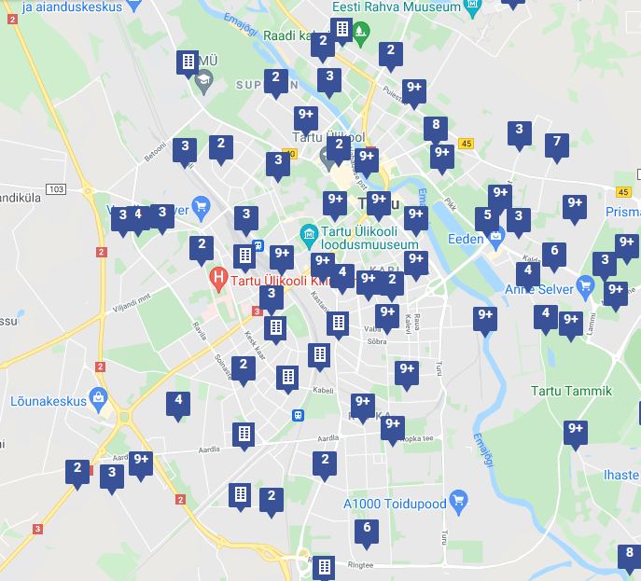
KV.ee
One of the top real estate sites in Estonia
Data scraping shouldn’t be difficult
Search parameters added to URL

Slide 5
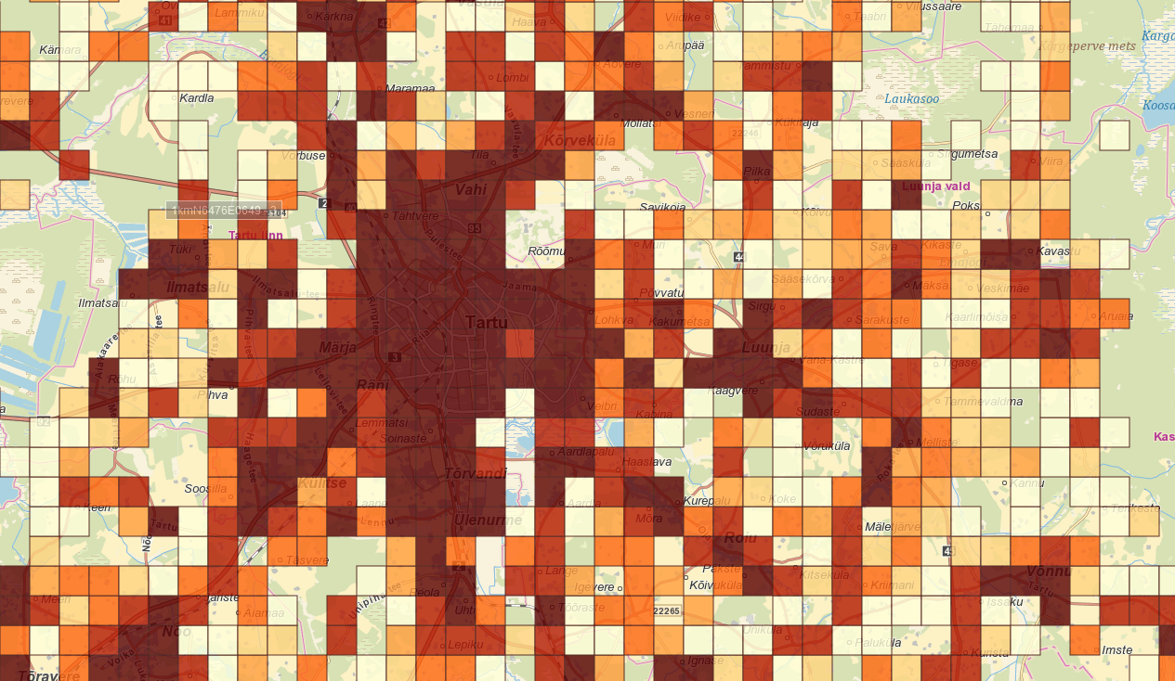
Approximate day-time population
Population density, 1 km^2 precision
Data can be downloaded in various formats
Precise, but data is from 2011
https://estat.stat.ee/StatistikaKaart/VKR

Slide 6
Goals
Goal 1: Predict the price of real estate based on a number of features
Goal 2: Find the features which most affect the price
Goal 3 (extra): Predict rent prices

